Slide 1
Password Checker
Project: Rajat Sethi

Slide 2
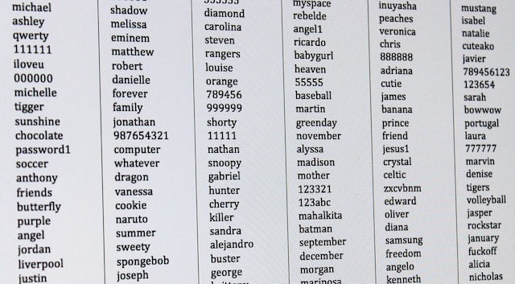
A Few Methods to Crack
Wordlists (rockyou.txt)
Brute-Force
Social Engineering
(Not Implemented)

Slide 3
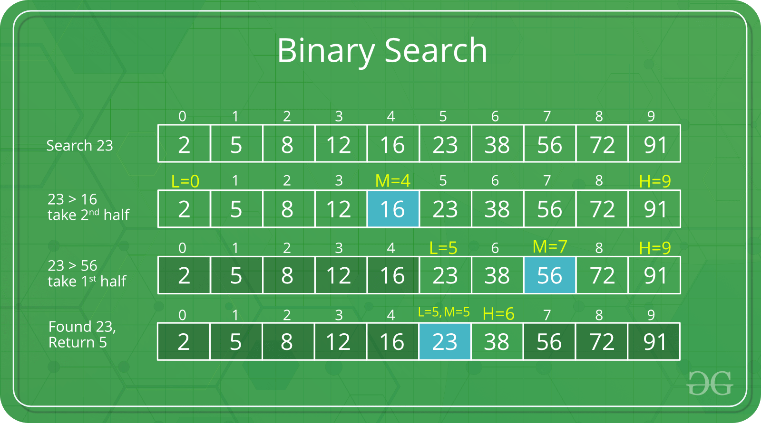
Binary-Search Wordlist
Load wordlist into array/vector beforehand.
Binary search through vector.
Allows for re-use - O(n + klog(n)) instead of O(kn).

Slide 4
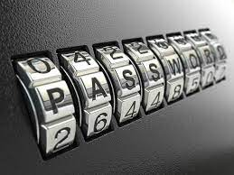
Brute-Force Algorithm
Use Recursion
Check all 1-character strings, 2-char, 3-char, etc.
Configure for maximum length or maximum search time.
Stop all other instances if match found.

Slide 5


Problems + Future Endeavors
Not configured for other wordlists (Easy)
Other configurations (Easy)
Brute-Force is O(n!) (Medium)
Other Optimizations (Hard)

